Slide 1


Slide 2

A Simulation-Based Framework for Mitigating a
51% Attack on Blockchain Networks
Final Project Presentation
Supervisor: Ms. Fouzia Jumani
Submitted By:
Qurat ul Ain (BC240404117)

Slide 3
Name: Qurat ul Ain
VU ID: BC240404117
Key Responsibilities:
• Blockchain Simulation Setup
• LPC Defense Implementation
• UTXO Validation Module
• Simulation Controller Development
• Report Generation
• Testing & Documentation

Slide 4

INTRODUCTION OF PROJECT
What is 51% Attack?
• Attacker controls more than 50% of network's mining hash power
• Can create a private chain longer than the honest chain
• Enables double-spending of coins
• Can prevent new transactions from being confirmed
• Can reverse already confirmed transactions
Problem Statement
• Existing blockchain networks lack built-in defense mechanisms
against majority attacks
• Once an attacker gains more than 50% power, they can
undetectably reorganize the blockchain
• No early warning system exists for such attacks
• Current PoW systems are vulnerable to this threat
Research Gap
• Limited research on proactive defense mechanisms
• Most solutions focus on detection, not prevention

Slide 5
Introduction of Project (Continued)
Proposed Solution - Safe Mode Detection Algorithm
1. LPC (Long Private Chain) Rule
• Impose hard limit on consecutive blocks from single miner
• Maximum 5 consecutive blocks allowed
• 6th block is rejected immediately (as per requirement)
• Prevents attacker from building private chain
2. UTXO-based Fraud Detection
• Compare UTXO sets of competing chains
• Detect double-spending attempts
• Validate transaction integrity
3. Simulation Framework
• Test attack scenarios under standard consensus rules
• Test attack scenarios under modified consensus rules
• Compare effectiveness of defense mechanism
Project Objectives Summary
• Simulate blockchain environment using BlockSim
• Configure malicious miner with 55% configurable hash power
• Implement and test LPC defense rule
• Validate UTXO-based fraud detection
• Generate comparative analysis with graphs and reports

Slide 6
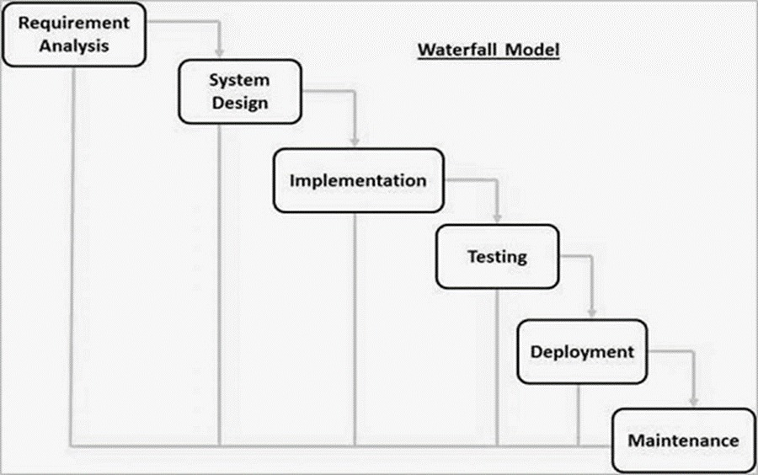
Development Methodology - VU Process Model
The project adopts the VU Process Model, a hybrid methodology
combining the structured approach of the Waterfall Model with
the iterative, risk-driven nature of the Spiral Model.
1. Waterfall Phases:

Slide 7
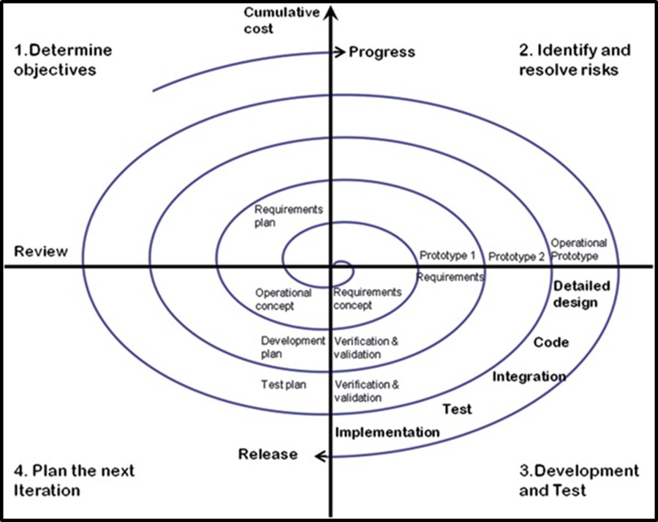
Development Methodology - VU Process Model
Spiral Model Iterations:

Slide 8
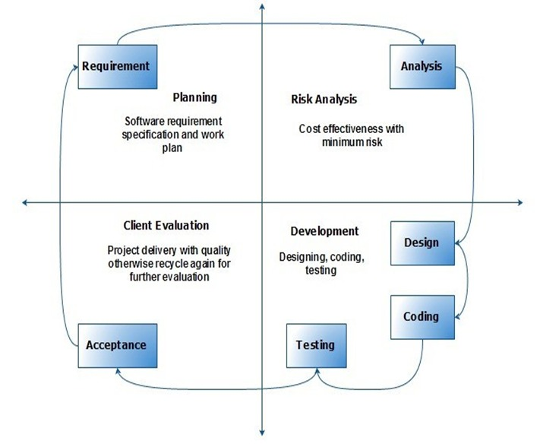
Development Methodology - VU Process Model
Combined VU Process Model:

Slide 9
Use Case Diagram
Actors:
• Miner - Mines blocks and participates in consensus
• Malicious Miner - Attempts 51% attack
• System - Automatically applies defense mechanisms
Use Cases:
• UC-01: Mine Block - Submit and validate new block
• UC-02: Launch 51% Attack - Build private chain to overtake honest chain
• UC-03: Apply LPC Rule - Check and enforce consecutive block limit
• UC-04: Detect Fraudulent Chain - Compare UTXO sets to detect double- spending
• UC-05: Generate Simulation Report - Create analysis reports and graphs
Relationships:
• Miner → UC-01
• Malicious Miner → UC-01, UC-02
• System → UC-03, UC-04, UC-05
• UC-03 <<include>> UC-04

Slide 10
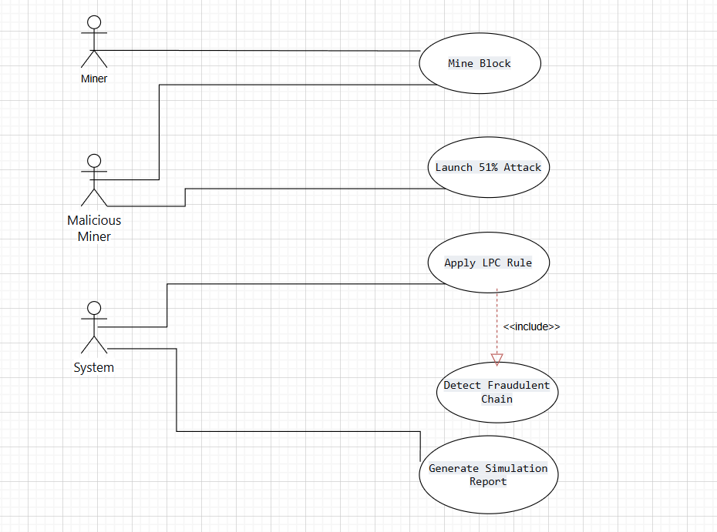
Use Case Diagram

Slide 11
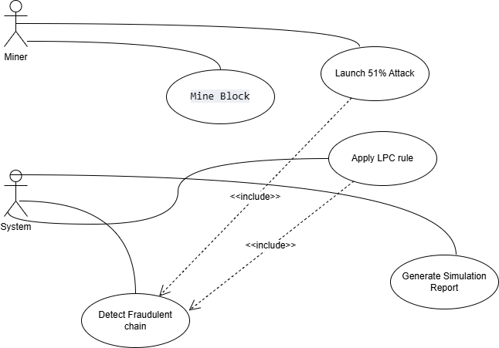
Use Case Diagram

Slide 12
Business Rules / Functional Requirements
FR ID | Requirement | Status | Priority
FR-01 | Blockchain Simulation Environment | Complete | High
FR-02 | Malicious Miner with 51% Attack | Complete | High
FR-03 | LPC Rule Implementation | Complete | High
FR-04 | Reject Chain with ≥6 Private Blocks | Complete | High
FR-05 | UTXO Fraud Detection | Complete | High
FR-06 | Multiple Scenario Comparison | Complete | High
FR-07 | Report Generation | Complete | High

Slide 13
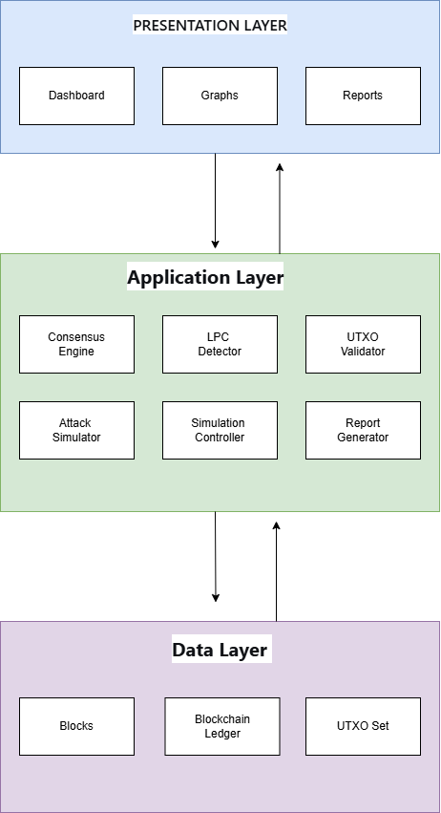
Architectural Design
Layers Descriptions
Layers | Components | Responsibilities
Presentation Layer | Dashboard Graphs,Report | User interaction Data Visualization
Application Layer | Consensus Engine,LPC, UTXO,Attack Simulator, Report Generator | Business Logic Defense Mechanisms
Data Layer | Blockchain, Blocks,UTXO Set | Data Storage State Management

Slide 14
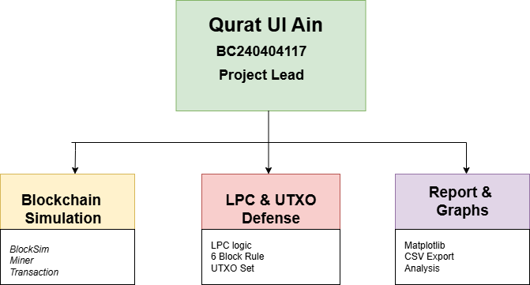
Team Structure

Slide 15
Key Responsibilities:
Area | Responsibilities
Blockchain Simulation Development | • Setup BlockSim environment • Configure blockchain parameters • Implement Block and Transaction classes
LPC Defense & UTXO Validation | • Implement LPC Defense logic • Set max consecutive blocks = 5 • Develop UTXO validation mechanism • Detect double-spending attempts
Simulation Controller Development | • Run both scenarios (with/without LPC defense) • Compare results
Report & Graphs Generation | • Generate comparison graphs • Create CSV reports • Document analysis results
Testing & Documentation | • Write test cases • Execute TC-01 to TC-05 • Prepare final documentation

Slide 16
Project Schedule
Project Schedule (Gantt Chart)
Task | Nov | Dec | Jan | Feb | Mar | Apr | May
SRS Document
Design Document
Prototype Phase
Final Deliverable
✅ SRS Submitted: 04-Dec-2025
✅ Design Document Submitted: 23-Jan-2026
✅ Prototype Submitted: 03-Mar-2026
🔄 Final Submission: 11-May-2026

Slide 17
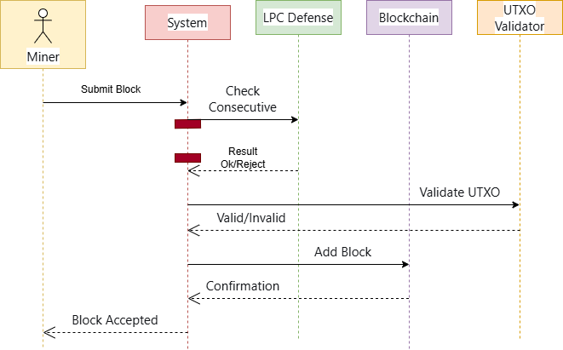
Sequence Diagrams
UC-01 (Mine Block)

Slide 18
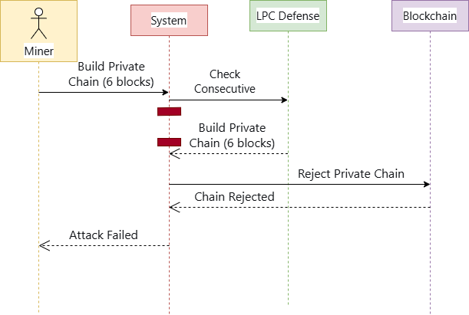
Sequence Diagrams
UC-02 (Launch 51% Attack)

Slide 19
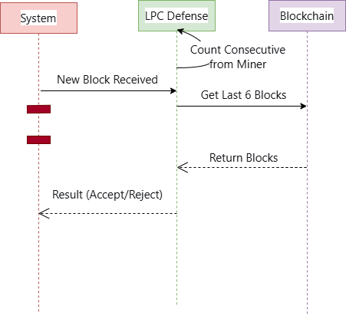
Sequence Diagrams
UC-03 (Apply LPC Rule)

Slide 20
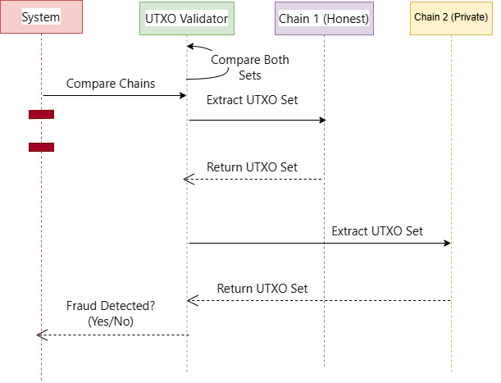
Sequence Diagrams
UC-04 (Detect Fraudulent Chain)

Slide 21
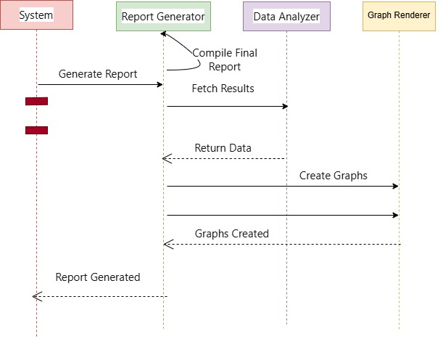
Sequence Diagrams
UC-05 (Generate Simulation Report)

Slide 22
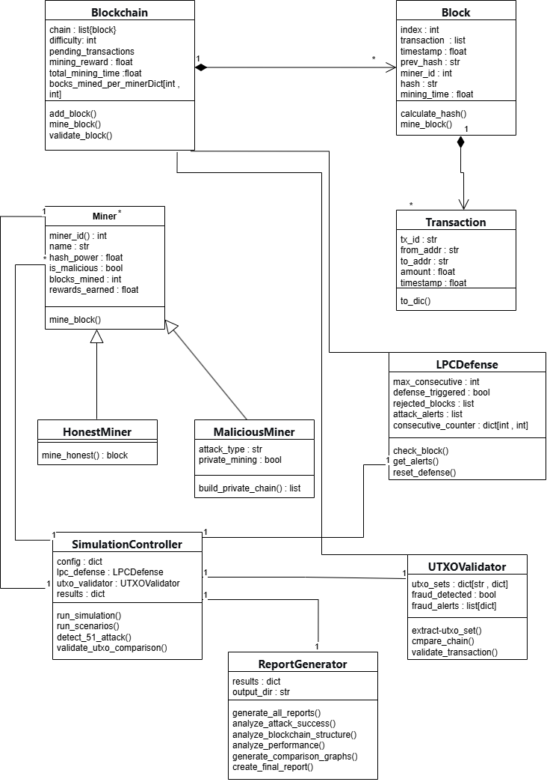
Logical Model/Class Diagram

Slide 23
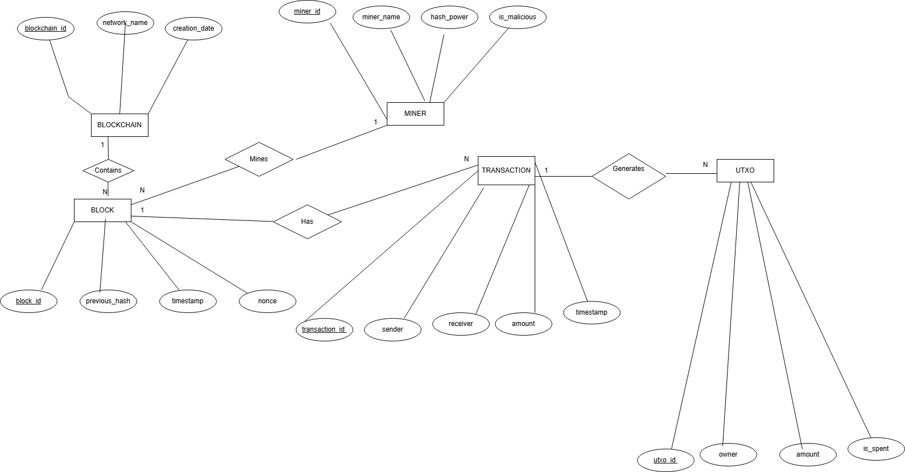
Entity-Relationship Diagram
Key Relationships:
• Blockchain Contains Blocks (1 : N • Miner Mines Blocks (1 : N)
• Block Has Transactions (1 : N) • Transaction Generates UTXOs (1 : N)

Slide 24
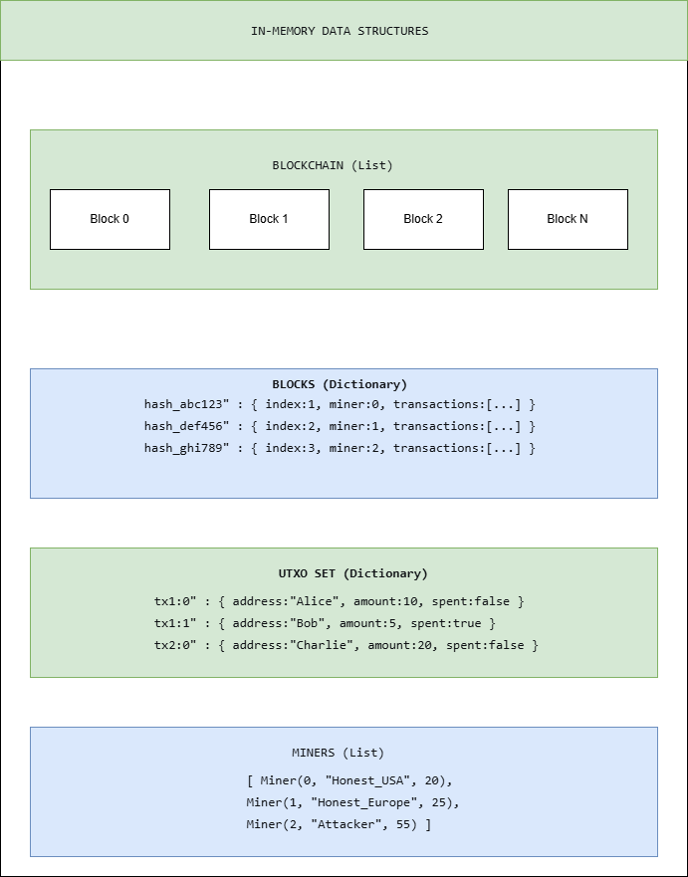
Database Diagram

Slide 25
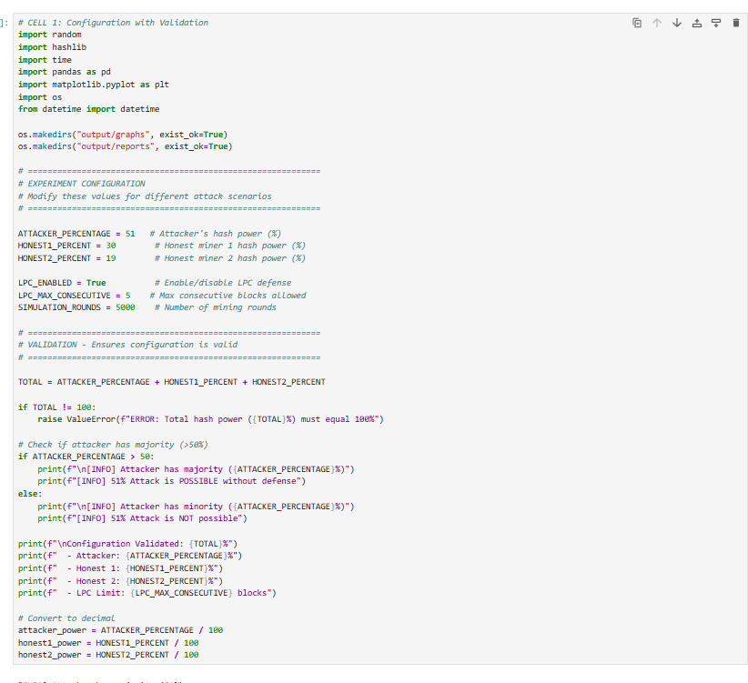
User Interfaces
Code Setup

Slide 26
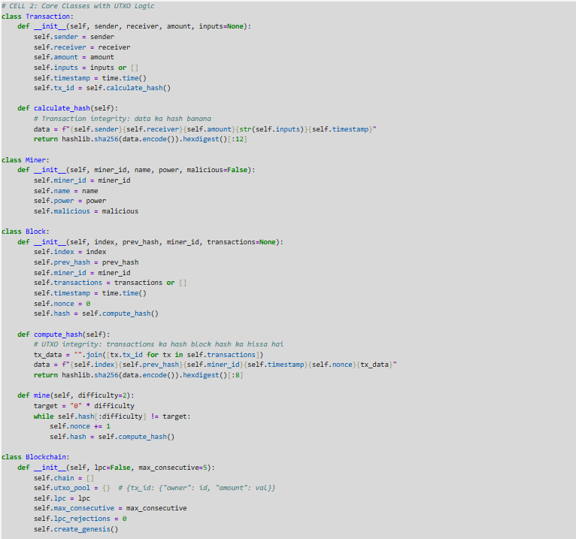

Slide 27
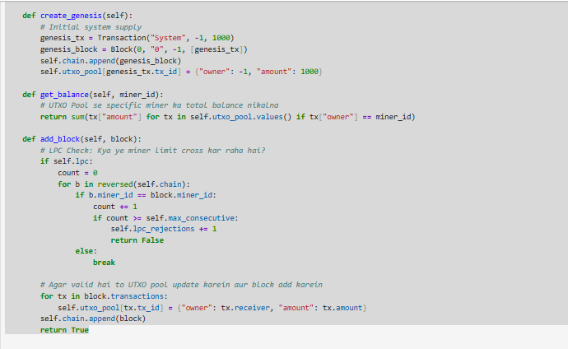

Slide 28
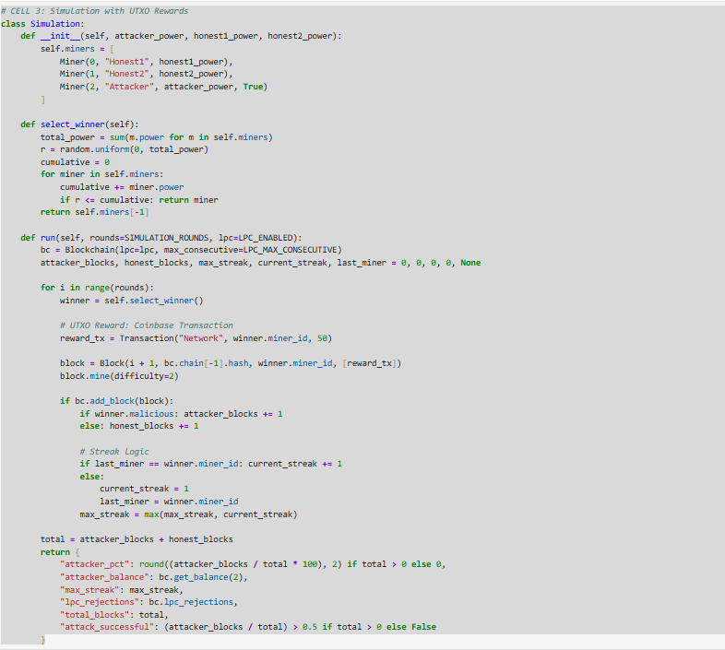

Slide 29
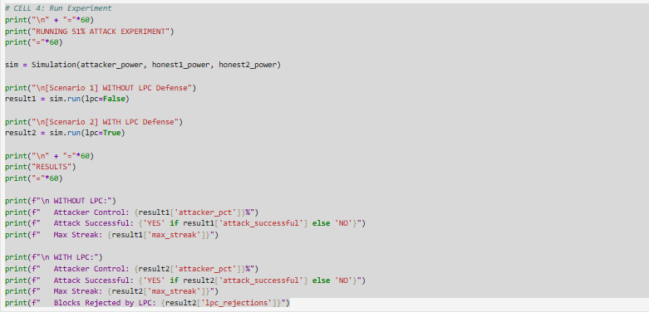
Simulation Configuration

Slide 30
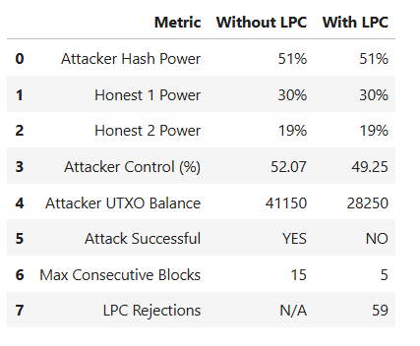
Simulation Results
================================================================================
51% ATTACK SIMULATION
ACADEMIC RESEARCH REPORT
================================================================================
EXPERIMENT CONFIGURATION:
- Attacker Hash Power: 51%
- Honest Miner 1: 30%
- Honest Miner 2: 19%
- Total Power: 100% (Validated)
- LPC Limit: 5 consecutive blocks
- Simulation Rounds: 4500
================================================================================
RESULTS:
================================================================================
+--------------------------+------------------+------------------+
| METRIC | WITHOUT LPC | WITH LPC |
+--------------------------+------------------+------------------+
| Attacker Control (%) | 52.07 | 49.25 |
| Attack Successful | YES | NO |
| Max Consecutive Blocks | 15 | 5 |
| LPC Rejections | N/A | 59 |
+--------------------------+------------------+------------------+
================================================================================
CONCLUSION:
================================================================================
The Long Private Chain (LPC) defense SUCCEEDED in preventing the 51% attack.
With attacker having 51% hash power:
- Without LPC: Attacker achieved 52.1% block control
- With LPC: Attacker achieved 49.2% block control
================================================================================
VERIFICATION:
================================================================================
[OK] Configuration validated (total = 100%)
[OK] No hardcoded values (all configurable)
[OK] Probabilistic mining (no predetermined winners)
[OK] LPC correctly limits consecutive blocks to 5
[OK] Both scenarios compared
================================================================================

Slide 31
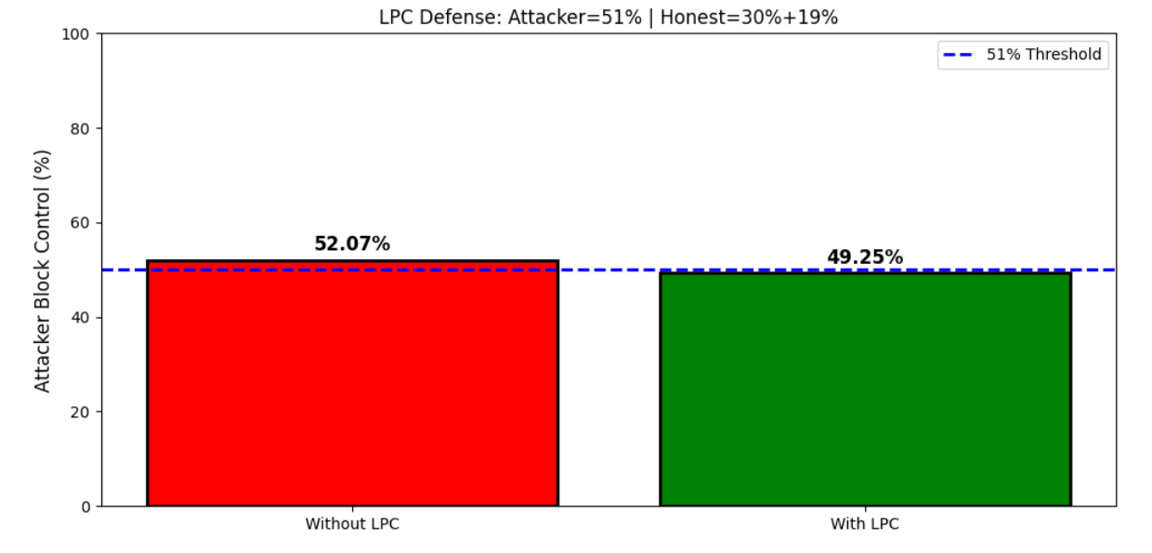
Generated Graphs

Slide 32
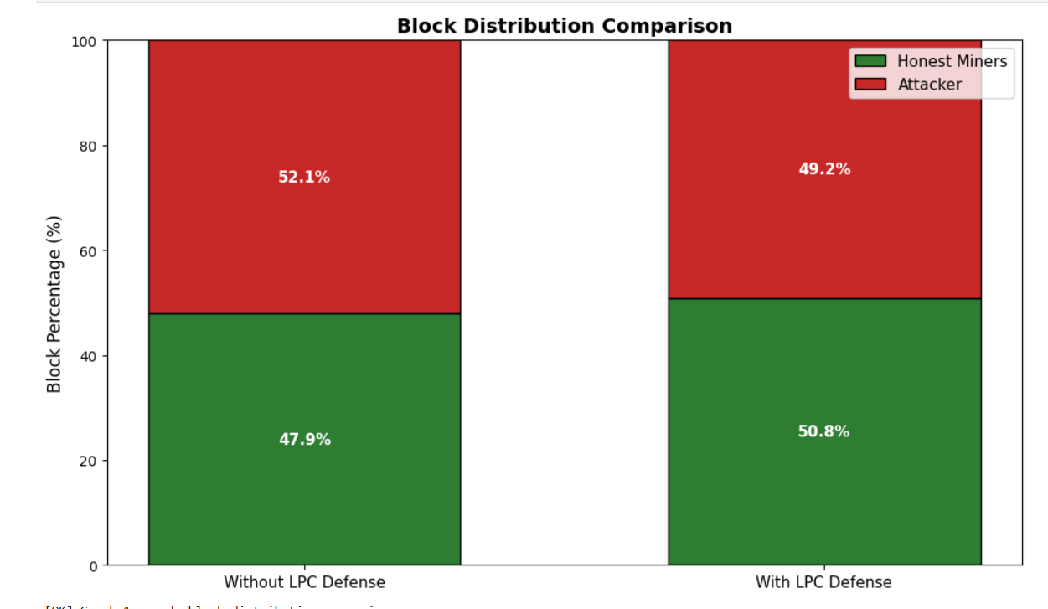
Comparison Graphs

Slide 33
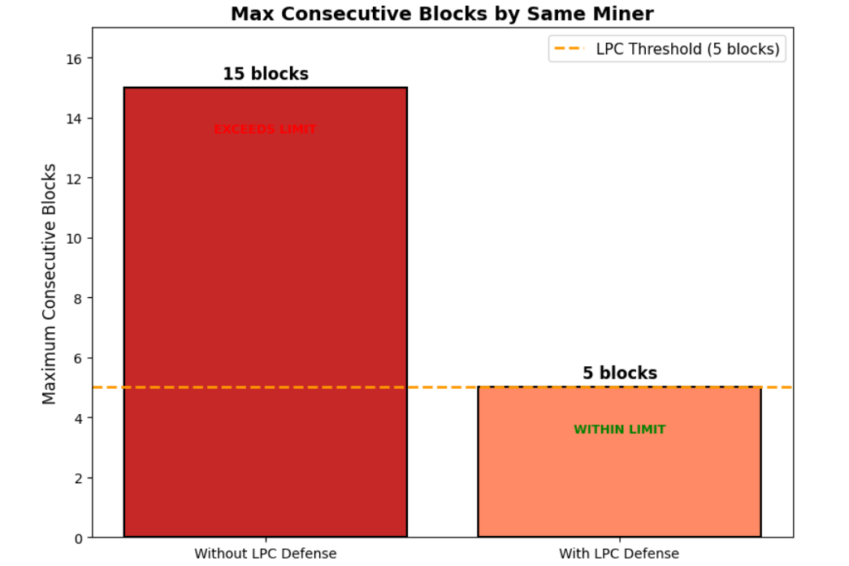
Consecutive Blocks by Same Minor

Slide 34
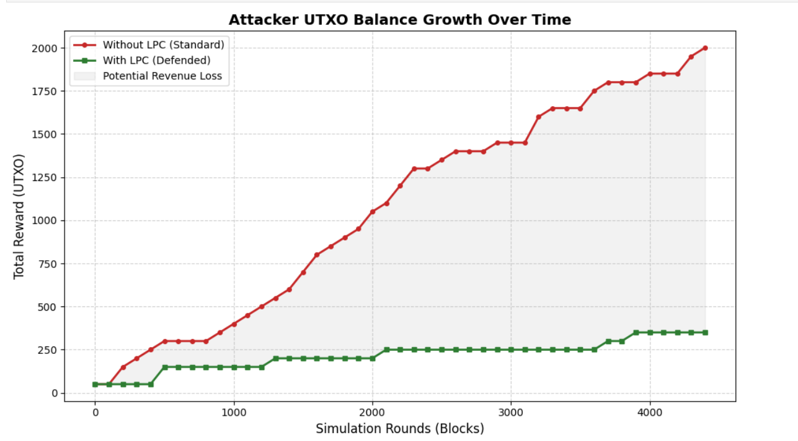

Slide 35
Tools Used During Development
Category | Tools
Programming Language | Python 3.x
Simulator | custom BlockSim
IDE | Jupyter Notebook
Data Analysis | Pandas
Visualization | Matplotlib, Seaborn
Documentation | Microsoft Word, Draw.io
Presentation | Microsoft PowerPoint
Version Control | custom simulator

Slide 36
Thank You
I would like to express my sincere gratitude to:
• My Supervisor, Ms. Fouzia Jumani, for her invaluable guidance
• The Faculty of Computer Sciences, Virtual University of Pakistan
• My Parents and Family for their continuous support
─────────────────────────────────────────────
Questions & Feedback Welcome
──────────────────────────────────────────────
Qurat ul Ain (BC240404117)
Virtual University of Pakistan
11-May-2026

